Slide 1
The Operating Model v1.24
= Marketing
= Store Operations
= Property
= Finance
= Space, Range, Display
= Information Technology
= Commercial
= People
= Forecast & Order
= Information
= Replenishment
= Operations Development
MANAGEMENT INFORMATION
Executive reports
Marketing reports
Property reports
Space, range and display reports
Commercial reports
Supply chain reports
Store reports
Finance reports
People reports
DEFINE THE OFFER
ACQUIRE,
BUILD & MAINTAIN
SPACE, RANGE & DISPLAY
BUY
MANUFACTURE
FORECAST & ORDER
PRIMARY DISTRIBUTION
STORE DISTRIBUTION
STORE SET-UP AND MAINTENANCE
STORE OPERATIONS
(REPLENISHMENT)
STORE OPERATIONS (SELLING)
EXIT
Understand customers
Researching site locations
Maintain accurate selling space and equipment data
Create category plan
Forecast expected unit sales
Manage flow of internationally sourced product
Setup & maintain distribution centre
Prepare for space, range & display activities in store
Layout store warehouse
Set retail price
Return stock to supplier
Lead the customer plan
Acquiring new site locations
Set space rules & write floor plan blueprints
Source & develop product
Forecast and balance network volumes
Manage flow of jointly bought products
Schedule distribution centre labour
Complete space, range & display activities in store
Receive stock into store
Execute promotions in store
Reduce to clear & waste stock
Trade planning
Manage development programme
Set & maintain floor plan for each store
Calculate purchase & sales tax
Order stock for stores
Transport & consolidate stock into distribution centres
Receive stock into distribution centre
Minimise shrink
In store production and display of products
Maintain price integrity
Set standards for developing buildings
Create and maintain the space, range and display schedule
Set up & maintain product throughout lifecycle
Order stock for distribution centres
Negotiate primary transport fees
Transfer stock between locations
Move stock to shelves
Serve customers at counters
Run local marketing
Setup, maintain and develop suppliers
Launch & run clubcard
Value management of property buying
Plan, manage & track all space, range & display activities
Order fuel for petrol stations
Pick & deliver stock to stores
Maintain accuracy of store stock records
Checkout service and performance
Monitor commercial performance & take action
Execute store stock take
Control tender movement
Communicate with customers
Create plans and designs for buildings
Build planograms
Plan & track buy for less
Plan deliveries into distribution centres
Maintain distribution centre stock records
Develop buildings and handover
Communicate ranges & planograms to supply chain & stores
Plan & commit to seasonal buys
Produce and review suggested allocation of stock
Maintain logistics income
Serve customers at checkouts
Maintain buildings
Set up a ranging framework
Create promotions
Raise & pass purchase order to suppliers
Return and control distribution equipment & packaging items
Control petrol station sales
Refresh stores
Procure goods & services not for resale
Control concession sales
Carry out negotiation
Drive distribution centre productivity
In store customer catering
Use distribution centre blueprints
Drive store productivity
Plan and build range
Plan product exit
OPERATIONS DEVELOPMENT
Operational insight
Solution generation
Trial & test of solution
Implement operational change
Step change in stores and warehouses
FINANCIAL CONTROL
Budget planning
Account for fixed assets
Validating sales & tender movements
Invoice matching
Control accounts payable
Control accounts receivable
Maintain stock ledger
Maintain general ledger
Processing payroll
Control treasury
Control currency
Track project costs
IT
OPERATIONS
Plan architecture & technology
Develop IT solutions
Deploy IT solutions
Operate & support IT
PEOPLE
Organising work
Recruiting our people
Live the values
Rewarding our people
Training & coaching
Listening & sharing information
Performance & development
Talent spotting
Supporting attendance
Managing personal & job information
Managing leavers
STRATEGIC OPERATIONS
Set promotions strategy & process
Set price strategy & process
Build the brand and format offer
Develop distribution centre network
Create commercial strategic plan
Set development programme
ISSUED 25^{trd} Jan 2007

Slide 2
IOD Space, Range & Display – Business team
IOD Space, Range & Display Director
Janet Smith
Best Practice Development Manager
Emma Kenyon
Range/Range Ops Project Manager
Mark Pettigrew
Space & Floor planning Project Manager
Mark Hillman
Implementation Manager (Turkey)
Mark Hobson
Implementation Manager (US)
Lucy Toussaint
Capability Manager
Jason Minnis
Project Manager
Display
Sharon Linger
Capability Manager
Darren Craven
Project Manager
Store processes
Steve Miller
Capability Manager
Richard Sparks
Design & Build team
Project Manager
Store-spec planograms
Chris Barber
Project Manager
MIS & Governance
TBD
Project Manager
Project planning
TBD

Slide 3
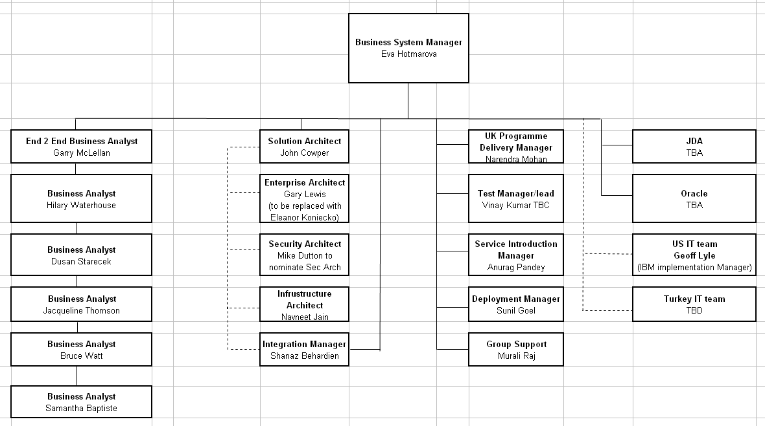
IOD Space, Range & Display – IT team
Design & Build team

Slide 4
Space Range and Display – Scope for TOM
Systems Required
Phase 1
Phase 2
Phase 3
Space modelling tool
Space Modelling
Space & equipment database
JDA Floor Planning
Floor planning tool
Automated floor plan generator
Automated Floor Plan generator
Schedule management tool
Develop in-house based on UK dotnet solution (Ranging Controls)
Ranging Controls tools
Display hierarchy mgmt tool
Cluster management tool
Space-to-range class matrix
Retail settings & controls
Range modelling tool
Range Modelling
Range system
Retek Assort
Reconciliation/workflow mgmt tool
Develop in-house based on UK
Central planogram system
JDA Space Planning
Automated planogram generator
Automated planogram generator
Store-specific planogram generator
SPOG’s planogram generator
Product mapping (& capacities)
Develop Store Line
Local Ranging
Store communication tool
SRD portal + JDA Web Publisher
Operational & Mgmt reporting
Develop in-house
Note: the aim is to deliver Phase 1 to US pre-opening. The outputs from Design workshops will suggest what’s actually possible with respect to timelines.

Slide 5
Space Range and Display – High Level Plan I.
September
  Finalising integration requirements
  Finalising cross functional requests with RMS, Ordering and Store Line
October
  Run design workshops on our applications to understand configuration requirements
  Give USA standalone versions of Space Planning and Floor Planning for modelling.
  Send merchandiser to USA for 2-3 weeks support
End of October
  The exact amount of work will be known i.e. what’s achievable and what’s not
  Decision will be made whether we can deliver everything which is our aim or whether we have to have pre opening and post opening launch
November - February
  Build
December – March
  System / Integration Test
April
  UAT
May
  Give systems to USA
  Support USA to get 1st stores onto Floor Planning and first ranges into Assort and Space Planning

